Slide 1
JavaFX

Slide 2
Goals
To describe JavaFX as a new GUI environment for Java
To understand and describe the organization and constituent parts of JavaFX programs
To compare and contrast the Swing API with JavaFX
Understand and use JavaFX
  layout managers
  Controls
  Menus
  Stylesheets (a bit)
  Visual effects (a bit)
Understand the roles of CSS and FXML in JavaFX

Slide 3
JavaFX Basics (from Oracle)
The basic structure of a JavaFX application:
  The main class for a JavaFX application extends the javafx.application.Application class.
  The start() method is the main entry point for all JavaFX applications.
  A JavaFX application defines the user interface container by means of a stage and a scene.
    The JavaFX Stage class is the top-level JavaFX container.
    The JavaFX Scene class is the container for all content.
Why JavaFX?
JavaFX documentation from Oracle

Slide 4
Some Introductory Materials
Materials are from Oracle (click to visit)
Swing vs JavaFX
http://www.dummies.com/programming/java/10-differences-between-javafx-and-swing/

Slide 5
JavaFX Basics (HelloWorld)
  HelloWorld example creates the stage and scene and makes the scene visible in a given pixel size.
  In JavaFX, the content of the scene is represented as a hierarchical scene graph of nodes.
  In HelloWorld, the root node is a StackPane object, which is a resizable layout node.

Slide 6
JavaFX Basics (HelloWorld)
The root node's size tracks the scene's size and changes when the stage is resized by a user.
The root node contains one child node, a button control with text, plus an event handler to print a message when the button is pressed.
The main() method is not required for JavaFX applications when the JAR file for the application is created with the JavaFX Packager tool, which embeds the JavaFX Launcher in the JAR file.
It is useful to include the main() method so you can run JAR files that were created without the JavaFX Launcher, such as when using an IDE in which the JavaFX tools are not fully integrated.
Swing applications that embed JavaFX code require the main() method.

Slide 7
public class HelloWorld extends Application {
@Override // gives message if signature is wrong
public void start(Stage primaryStage) {
Button btn = new Button();
btn.setText("Say 'Hello World'");
btn.setOnAction(new EventHandler<ActionEvent>() {
@Override
public void handle(ActionEvent event) {
System.out.println("Hello World!");
}
});
StackPane root = new StackPane();
root.getChildren().add(btn);
Scene scene = new Scene(root, 300, 250);
primaryStage.setTitle("Hello World!");
primaryStage.setScene(scene);
primaryStage.show();
}
public static void main(String[] args) {
launch(args);
}
}

Slide 8
Adding Items into a Scene
Basic approach:
  Override Start()
  Create instances of the desired items
  Create event handlers for the items and attach the event handlers to the items
  Create a container for the items
  Add the items to the container
  Add the container into the scene
  Add the scene to the stage

Slide 9
public class Login extends Application {
@Override
public void start(Stage primaryStage) {
primaryStage.setTitle("JavaFX Welcome");
GridPane grid = new GridPane();
grid.setAlignment(Pos.CENTER);
grid.setHgap(10);
grid.setVgap(10);
grid.setPadding(new Insets(25, 25, 25, 25));
Text scenetitle = new Text("Welcome");
scenetitle.setFont(Font.font("Tahoma", FontWeight.NORMAL, 20));
grid.add(scenetitle, 0, 0, 2, 1);
Label userName = new Label("User Name:");
grid.add(userName, 0, 1);
TextField userTextField = new TextField();
grid.add(userTextField, 1, 1);
Label pw = new Label("Password:");
grid.add(pw, 0, 2);
PasswordField pwBox = new PasswordField();
grid.add(pwBox, 1, 2);

Slide 10
Button btn = new Button("Sign in");
HBox hbBtn = new HBox(10);
hbBtn.setAlignment(Pos.BOTTOM_RIGHT);
hbBtn.getChildren().add(btn);
grid.add(hbBtn, 1, 4);
final Text actiontarget = new Text();
grid.add(actiontarget, 1, 6);
btn.setOnAction(new EventHandler<ActionEvent>() {
@Override
public void handle(ActionEvent e) {
actiontarget.setFill(Color.FIREBRICK);
actiontarget.setText("Sign in button pressed");
}
});
Scene scene = new Scene(grid, 300, 275);
primaryStage.setScene(scene);
primaryStage.show();
}
}

Slide 11
JavaFX Menus
Basic Approach to the creation of menus:
  Create a menu
  Create menu items
  Add event handlers to the menu items
  Add items to the menu
  Create a container for the menu
  Add the menu to the container
\NEWTOPICS\JavaFX\EditorProject\MenuDemo.java

Slide 12
Menus and Menu handling
public void start(Stage stage) {
// Create MenuBar
MenuBar menuBar = new MenuBar();
// Create menus
Menu fileMenu = new Menu("File");
Menu editMenu = new Menu("Edit");
Menu helpMenu = new Menu("Help");
// Create MenuItems
MenuItem newItem = new MenuItem("New");
newItem.setOnAction(new EventHandler<ActionEvent>() {
@Override
public void handle(ActionEvent event) {
System.out.println("Chose the file-new");
}
}
);

Slide 13
Dialogs
Several types and examples:
  Alerts
  Confirmations
  Choice dialogs
  Text Dialogs
New concept: Optional
  A discussion of class Optional

Slide 14
JavaFX Drawing Geometric Shapes
Utilizes an instance of class Canvas
Utilizes a GraphicsContext
Utilizes class Group - A Group contains an ObservableList of children that are rendered in order when this node is rendered:
  Group g = new Group();
  for (int i = 0; i < 5; i++) {
  Rectangle r = new Rectangle();
  r.setY(i * 20);
  r.setWidth(100);
  r.setHeight(10);
  r.setFill(Color.RED);
  g.getChildren().add(r);
  }
  NEWTOPICS\JavaFX\DrawingShapes\TimelineAnimationExample.java

Slide 15
Drawing Geometric Shapes
public void start(Stage primaryStage)
{
primaryStage.setTitle("JavaFX Drawing Test");
getData();
Group root = new Group();
Canvas canvas = new Canvas(360, 500);
GraphicsContext gc = canvas.getGraphicsContext2D();
drawShapes(gc);
root.getChildren().add(canvas);
primaryStage.setScene(new Scene(root));
primaryStage.show();
}
NEWTOPICS\JavaFX\DrawingShapes\ShapeDrawer.java

Slide 16
Drawing Geometric Shapes
public void drawShapes(GraphicsContext gc)
{
for(Line l:lines)
gc.strokeLine(l.x1,l.y1,l.x2,l.y2);
for(Circle c:circles)
gc.strokeOval(c.x1,c.y1,c.radius,c.radius);
}

Slide 17
Displaying Images
Simplified compared to media managers of the past
Flowers example …
    . . .\JavaFX\Images\ImageExample.java

Slide 18
The Usual Stuff …
ImageView iv2 = new ImageView();
iv2.setImage(image);
iv2.setFitWidth(100);
iv2.setPreserveRatio(true);
iv2.setSmooth(true);
iv2.setCache(true);
. . .
Group root = new Group();
Scene scene = new Scene(root);
HBox box = new HBox();
. . .
box.getChildren().add(iv2);
stage.setScene(scene);
stage.sizeToScene();
stage.show();

Slide 19
JavaFX Form Example
Creating a form is a common activity when developing an application.
a GridPane layout allows creation of a flexible grid of rows and columns in which to lay out controls.
Place controls in any cell in the grid, and you can make controls span cells as needed.
The alignment property changes the default position of the grid
The gap properties manage the spacing between the rows and columns
The scene is created with the grid pane as the root node.
As the window is resized, the nodes within the grid pane are resized according to their layout constraints.
In this example, the grid pane remains in the center when the window grows or shrinks.

Slide 20
JavaFX Form Example (cont)
Text objects cannot be edited.
Alternative ways to create a Text object:
  Using an inline style is appropriate where the style is bound to a variable.
  A better technique for styling the elements of your user interface is by using a style sheet (next example).
The grid.add() method adds the scenetitle variable to the layout grid.
The numbering for columns and rows in the grid starts at zero, and scenetitle is added in column 0, row 0.
Creating a Label object. The example creates:
  a text label “User Name” at column 0, row 1
  a Text Field object that can be edited.
The text field is added to the grid pane at column 1, row 1.
A password field and label are also created and added.

Slide 21
JavaFX Form Example (cont)
When working with a grid pane, the grid lines can be displayed - useful for debugging purposes.
Add grid.setGridLinesVisible(true) after the line that adds the password field.
The final two controls required for the application are a Button control for submitting the data and a Text control for displaying a message when the user presses the button.
Create the button and position it on the bottom right, which is a common placement for buttons that perform an action affecting the entire form.

Slide 22
JavaFX Form Example (cont)
The first line creates a button named btn with the label Sign in, and the second line creates an HBox layout pane named hbBtn with spacing of 10 pixels.
The HBox pane sets an alignment for the button that is different from the alignment applied to the other controls in the grid pane. The alignment property has a value of Pos.BOTTOM_RIGHT.
The button is added as a child of the HBox pane, and the HBox pane is added to the grid in column 1, row 4.
A Text control is added to display the message.
The button displays the text message when the user presses it.
The setOnAction() method is used to register an event handler that sets the actiontarget object to Sign in button pressed when the user presses the button.
The color of the actiontarget object is set to firebrick red.

Slide 23
Integrating Swing and JavaFX
Swing and JavaFX will co-exist for some time as migration to JavaFX is expensive.
An intermediate step might include extending Swing applications with JavaFX
JavaFX content must be added correctly into a Swing application for both Swing and JavaFX content to operate within a single application.
JavaFX SDK provides the JFXPanel class, which is located in the javafx.embed.swing package and enables embedding JavaFX content into Swing applications.

Slide 24
Integrating Swing and JavaFX
Adding JavaFX Content to a Swing Component
  Swing applications have GUIs created on an event dispatch thread (EDT).
Approach to integrating Swing and Java FX:
  Create a JFrame component and add a JFXPanel object to it.
  Creating an instance of the JFXPanel class implicitly starts the JavaFX runtime.
  After the GUI is created, the initFX() method creates the JavaFX scene on the JavaFX application thread.
  Examples:
  NEWTOPICS\SwingAndFX\HelloWorld\Test.java
  NEWTOPICS\SwingAndFX\Converter\Converter.java

Slide 25
Login.java with CSS example
JavaFX applications can utilize Cascading Style Sheets (CSS)
  Remove styling information from the application
  Create the Style Sheet,
  Voila!!
Netbeans provides capabilities to do this
Notes:
  The background image is applied to the .root style, which means it is applied to the root node of the Scene instance.
  The style definition consists of
  the name of the property (-fx-background-image)
  the value for the property (url(“background.jpg”)).
Creating CSS with Netbeans Pt1
  File-New-Other-Cascading StyleSheet
Creating CSS with Netbeans Pt2

Slide 26
Added Code for CSS
Scene scene = new Scene(grid, 300, 275);
primaryStage.setScene(scene);
scene.getStylesheets().add
(Login.class.getResource("Login.css").toExternalForm());
primaryStage.show();
scenetitle.setId("welcome-text");
actiontarget.setId("actiontarget");
Example:
NEWTOPICS\JavaFX\LoginCSS\

Slide 27
Layout Managers
LayoutManagers in Swing and JavaFX
Java Swing Layouts:
  BorderLayout
  BoxLayout
  CardLayout
  FlowLayout
  GridBagLayout
  GridLayout
  GroupLayout
  SpringLayout

Slide 28
Java FX Layouts
Example code with handlers (on some)

Slide 29
Java FXML
FXML is an XML-based user interface markup language created by Oracle Corporation to define the user interface of a JavaFX application.
An alternative to constructing such graphs in procedural code
Well suited to define the user interface of a JavaFX application
The hierarchical structure of an XML document closely parallels the structure of the JavaFX scene graph.
Anything that is created or implemented in FXML can be expressed using JavaFX directly.
Netbeans provides a special type of Project for this purpose.

Slide 30
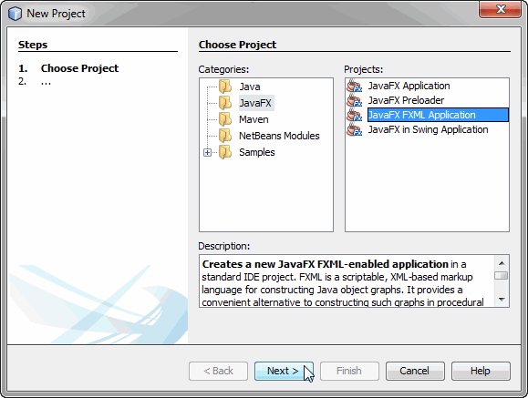
Creating an FXML Project

Slide 31
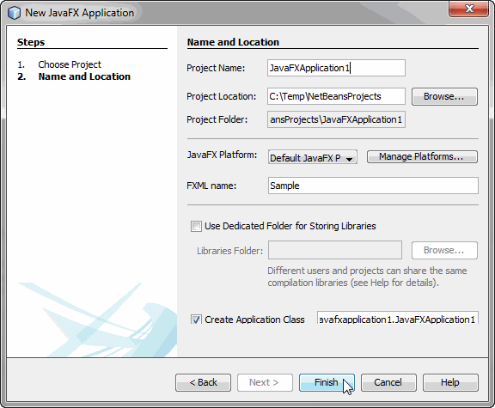
Naming the Project

Slide 32
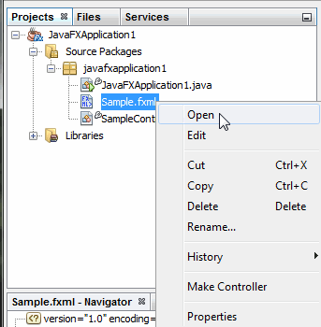
Accessing the FXML

Slide 33
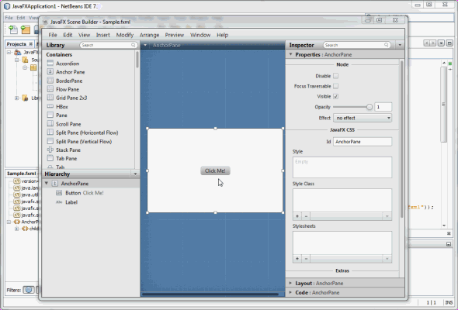
Editing the FXML

Slide 34
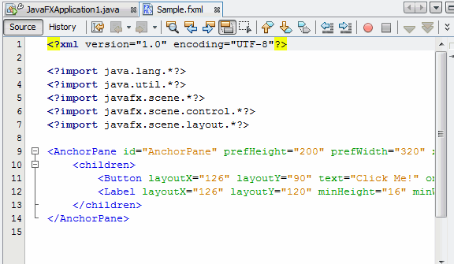
Looking at the Generated XML

Slide 35
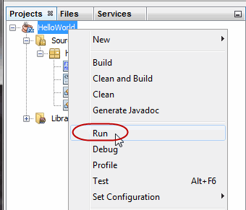
Running the Project

Slide 36
JavaFX Animations
Two types of animation supported by JavaFX:
Timeline animation: The effect is created by adding key frames to a timeline.
  intermediate frames are generated by JavaFX with the help of an interpolator.
  gives more control to manipulate animation effect.
  Programmatic update of property values of animated objects such as changing size, color, location, and so on.
  start and end snapshots denoted by the keyframes
  intermediate frames generated by the interpolator
  facilitates stopping, pausing, resuming, reversal, or repeat
Transition: Transition animation is best suited for a planned animation
  incorporates animation in an internal timeline.
  There are several concrete transition classes with which we can compose multiple animations that can be executed in parallel or sequentially.
  Example:
    the RotateTransition class implements a rotating effect by changing the degree of rotation of a node over time.
    comparatively simplified technique; easier to use than timeline animation.

Slide 37
Summary
JavaFX will coexist with Swing for some time to come but it will ultimately replace Swing
JavaFX introduces cascading stylesheets and FXML descriptions of GUI elements
Provides a different means of creating GUIs compared with AWT and Swing.

